Slide 1


Shared Libraries
Federico Naum
Sydney Jenkins Meetup 19th July, 2017
Notes:
My name is.
Work for animal logic
CONTEXT
At Animal we have been using Jenkins for the last eight years, but only a year ago when Jenkins 2.0 was out we started using Jenkins pipelines Shared Libraries for about 4 months now.
Share libraries have been there for a while (2014/2015)
Who is using Jenkins pipelines? Who has attended or watched Malcom’s awesome presentation.
And last one. Who is currently using shared pipelines… (what is your name?)
Let’s make this presentation interactive, so feel to interrupt at any point and ask questions that will be answered by NAME
1

Slide 2

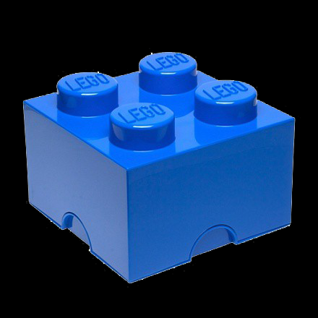
Agenda
Why Shared Libraries
Configuration and options
Library structure
Usage
Modification workflow
Lessons Learnt
Notes:
Wildstyle will be running the agenda... She’ll make sure I don't start rumbling
2

Slide 3
Agenda
Why Shared Libraries
Configuration and options
Library structure
Usage
Modification workflow
Lessons Learnt
Notes:
I have to say that before “pipelines as code” and shared libraries we hit several limitations with Jenkins and where we had to create some man in the middle and with glue code.
We were even thinking in finding a replacement, but I have to say that things have improved a lot since Jenkins 2. we have removed many of those workarounds and we are enjoying the benefits of pipelines in general.
3

Slide 4

Why Shared Libraries
Abstract Complexity
Notes:
COMPLEXITY
[To give you some context we had hundred of tools and they all have their own build and release scripts. (and of course de documentation in the wiki was outdated)
But after some work and with the help of a tool called rez we managed to build tests and release all the tools with the same command. We have now more than one thousand interdependent pieces of software in for of rez packages and about 15000 packages versions.]
On the text books you find some jobs like this.
Build a library -> Run UT -> Run Integration Test - > deploy
But our reality is that our software toolchain is complex we have a lot of software with interdependencies.. it look like this..
In a giving environment to render a maya scene we have 300+ different software pacakges, so you can imagine that our Jenkins jobs do not look like this.
Some of the jobs ....
4

Slide 5
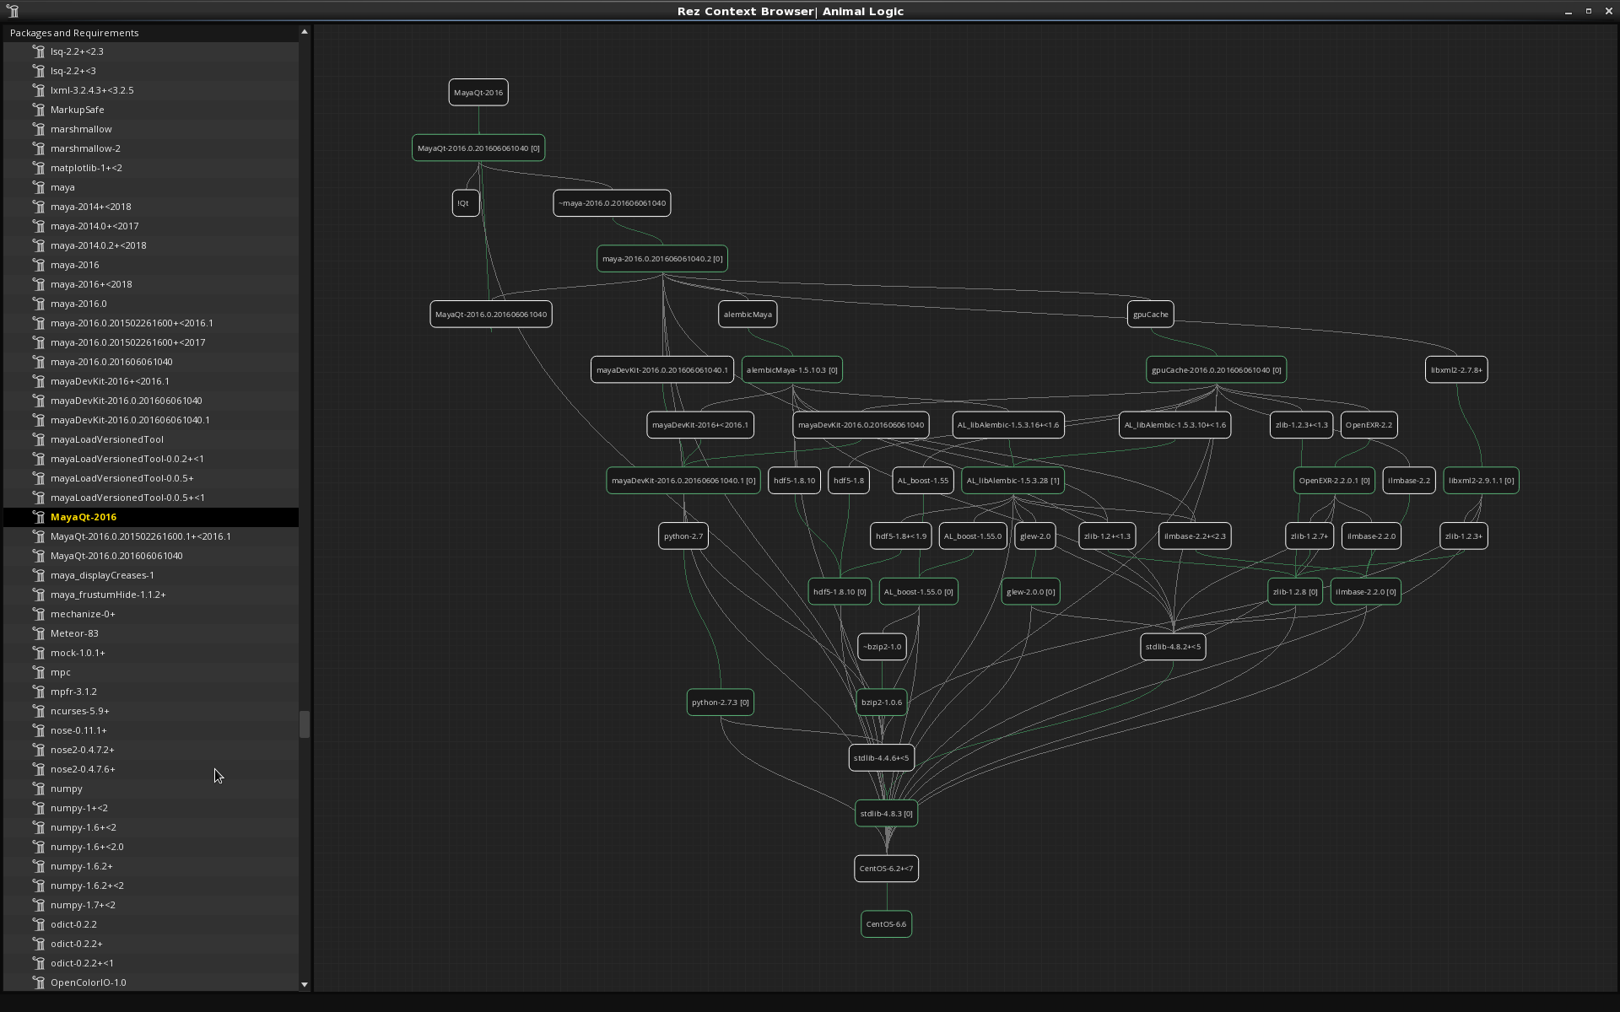
Notes:
Tha't the

Slide 6
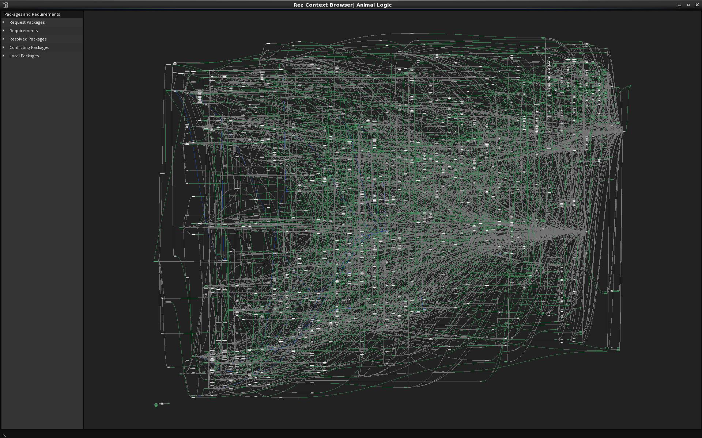

Slide 7
Why Shared Libraries
Abstract Complexity
Maintainability
Promote code reuse
Avoid code duplication
Notes:
MANTAINABILITY
The same thing you do with c ++, java, python code is to create a library (a dll or dso file) so you want to write it once and have multiple pieces of software using it.
Jenkins pipelines are code as well (either pure groovy or declarative pipeline but code in the end) so we want to reuse it and avoid writing the same thing twice, right?
7

Slide 8
Why Shared Libraries
Abstract Complexity
Maintainability
Promote code reuse
Avoid code duplication
Global changes
Apply changes to all pipeline jobs
Notes:
But more importantly we can change things In one place and that gets applied to all our jobs. (there used to be a slice configuration plugin that allowed you to find Jenkins jobs
8

Slide 9
Why Shared Libraries
Abstract Complexity
Maintainability
Promote code reuse
Avoid code duplication
Global changes
Apply changes to all pipeline jobs
Avoid monster pipelines
Notes:
AVOID hard to maintain monster pipelines.
And to avoid monster pipelines!!!!
9

Slide 10


Monster Pipelines
Notes:
In the Lego world giving freedom to create pipelines you end up with something like this
And in Jenkins pipeline you end up with something like this...
What can we see here …No declarative/Three languages/Code repetition/ Double escape / lots of nesting levels…. Well no need to be genius to know that this is a sort of unmaintainable pipeline
It there is time we can go in how to convert this monster in something readable and more maintainable
10

Slide 11

Notes:
LiveSlide Site
https://github.com/AnimalLogic/jenkins_pipeline/blob/master/JenkinsfileRez
11

Slide 12
Agenda
Why Shared Libraries
Configuration and options
Library structure
Usage
Modification workflow
Lessons Learnt
Notes:
12

Slide 13

Configuration and options
Install Pipeline Shared Groovy Libraries plugin
Two modes
Legacy mode
single git repo in Jenkins
General mode
Any scm
Multiple sources
Notes:
Let jump into the configuration
You will need the Jenkins pipeline Pipeline Shared Groovy Libraries Plugin installed
There are two modes. (read them)
For this presentation we are only going to focus in the General mode only. [The instruction to use the legacy mode are on a link at the end of the slides.]
13

Slide 14
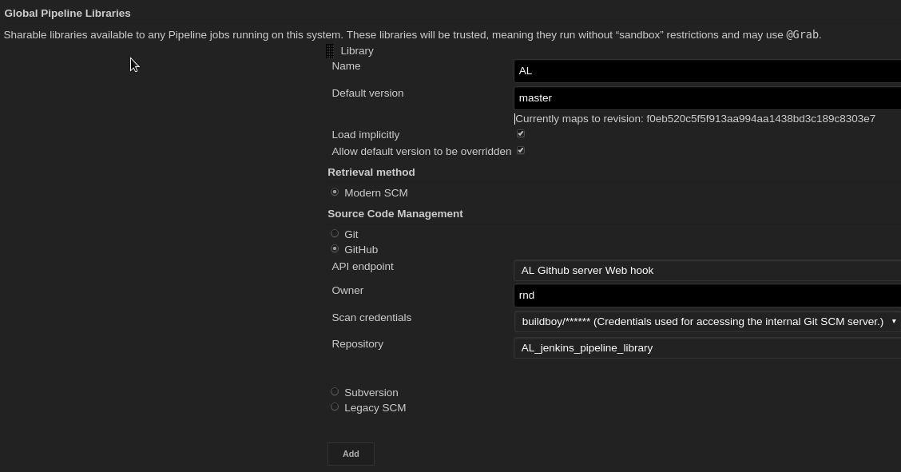
Configuration and options
Notes:
Jump to jenkins and use this parameters. User: AnimalLogic Repo: batman_shared_library
One particular note here is that this shared pipeline are not sandboxed, so if you have being hitting this annoying thing that need to approve each groovy method on the In-process Script Approval you will be happy with this .
These libraries are considered "trusted:" they can run any methods in Java, Groovy, Jenkins internal APIs, Jenkins plugins, or third-party libraries. This allows you to define libraries which encapsulate individually unsafe APIs in a higher-level wrapper safe for use from any Pipeline. Beware that anyone able to push commits to this SCM repository could obtain unlimited access to Jenkins.
Explain options
Furthermore, if you specify a version in Jenkins configuration, you can block scripts from selecting a different version
We have not setup our Shared library. You can define as many as you want.
Set a library called batman use batman_shared_library repo set to load implicitly (all jenkins pipelies will make a checkout of this repo now)
Create a job in repo AL_Jenkins_pipeline and make it fail 'batmobile_pipe'.
Luckily this gives a descriptive error saying that “ “ (if you are been working with Jenkins pipeline you’ll already know that this is not true all the time, some time the errors are quite obscure)
We live that like this because that bring us to the next slide, What is the library structure
14

Slide 15
Agenda
Why Shared Libraries
Configuration and options
Library structure
Usage
Modification workflow
Lessons Learnt
Notes:
Wildstyle bring us the agenda for today
15

Slide 16

Directory structure
(root)
+- src
| +- al
| +- foo
| +- Bar.groovy
+- vars
| +- foo.groovy
| +- foo.txt
+- resources
| +- org
| +- al
| +- bar.py
| +- foo.bash
Notes:
We are going to see example later, for now I would just explain the options.
SRC
As you can see the src directory looks like a Java source directory structure. This directory gets added to the classpath when executing Pipelines., so you do your imports as you would with any groovy
VARS
In the vars directory you can store scripts that define global variables and functions that can be accessed from your pipeline. That’s the one that we are using the most, since from our team of 30-40 developers only 10 are java developers . Most of the people writing pipelines come from python, so not much structured Java.
To be picked up you need the files to be .groovy. The matching txt file is optional but I recommend that you always document them because that documentation is displayed in the UI so users can just have a look there to see what is available and how to use it and not need to check the actual library.
The documentation file need to be called the same name as the groovy file and needs to have the txt extension. The contents can be written in HTML or Markdown, but in my experience we were only able to make it work with HTLM (I haven’t tried again with the latest changes)
[The Groovy source files in these directories get the same “CPS transformation” as in Scripted Pipeline.]
In the resources directory, you can add all your non-Groovy files. And you can load them into your pipelines using the libraryResource step.
In our case we use to make lot of use of the Managed scripts and write bash and python helpers , so they should end up in this directory. Later we will see a couple of example on how to use this resources.
Now we are gonig to create this file structure (merge branch called file_structure
16

Slide 17
Agenda
Why Shared Libraries
Configuration and options
Library structure
Usage
Modification workflow
Lessons Learnt
Notes:
Wildstyle bring us the agenda for today
17

Slide 18
Usage
 | Global Variables/Functions | Class library | Resources
Contents | Any Groovy code | Any Groovy code | Any Non groovy code
Static Invocation (Annotation) | @Library('my-shared-library') _ | @Library(‘rez') import com.al.rez.BuildClass
Dynamic invocation (step) | library 'my-shared-library' | library(’rez’).com.al.rez.BuildClass.builds() | def script = libraryResource(‘al/python/rez/diff_env.py)
Resolution | At run time | At compile time | At run time
Access pipeline steps directly | YES | NO | N/A
Access env vars directly | YES | NO | N/A
Notes:
So how to access it
@Library('my-shared-library') _
/* Using a version specifier, such as branch, tag, etc */
@Library('my-shared-library@1.0') _
/* Accessing multiple libraries with one statement */
@Library(['my-shared-library', 'otherlib@abc1234']) _
When referring to class libraries (with src/ directories), conventionally the annotation goes on an import statement:
@Library('somelib')
import com.mycorp.pipeline.somelib.UsefulClass
For Shared Libraries which only define Global Variables (vars/), or a Jenkinsfile which only needs a Global Variable, the annotation pattern @Library('my-shared-library') _ may be useful for keeping code concise. In essence, instead of annotating an unnecessary import statement, the symbol _ is annotated.
It is not recommended to import a global variable/function, since this will force the compiler to interpret fields and methods as static even if they were intended to be instance. The Groovy compiler in this case can produce confusing error messages.
There is a reason for that _ that took it more than a day to figure it out. Currently that notation and the explanation is on the main documentation.
What it says is that instead of annotating an unnecessary import statement, the symbol _ is annotated.
For Class libraries the Annotation goes on an import statement
But when I was re-reading the documentation to create this presentation I found that after one of the release they have created a library step , so you can now at any time in your pipeline call library ‘my-shared-lib’ and after that you can use any method or global variable defined there. ( I tested and works fine)
3) The difference is that in when accessing branches of that library you could for example have something like library "my-shared-library@$BRANCH_NAME”
4) Libraries are resolved and loaded during compilation of the script, before it starts executing. This allows the Groovy compiler to understand the meaning of symbols used in static type checkin
Global Variables however, are resolved at runtime.
Internally, scripts in the vars directory are instantiated on-demand as singletons. This allows multiple methods or properties to be defined in a single .groovy file which interact with each other
5) It feels to me that when you write global functions is like abstracting some common usage in existing pipelines, and code in the class libraries is more like new functionality. But it might be just me. The code in Global functions could look like declarative pipelines where class reassemble more like java code.
18

Slide 19

Usage
Notes:
19

Slide 20
Usage
Convert Frankenstein pipeline to declarative using Shared Libs
Notes:
Highligh trick to run bash
Trick to run python
20

Slide 21
Notes:
LiveSlide Site
https://github.com/AnimalLogic/jenkins_pipeline/blob/master/JenkinsfileRez
21

Slide 22
Usage
Convert Frankenstein pipeline to declarative using Shared Libs
Create declarative structure
Enclose all non-step code in scripts {}
Move all non-groovy code to resources and us loadResources
Extract commonalities and create global functions in var
Notes:
Highligh trick to run bash
Trick to run python
22

Slide 23
Notes:
LiveSlide Site
https://github.com/AnimalLogic/jenkins_pipeline/blob/master/JenkinsfileRez2
23

Slide 24
Usage
Convert Frankenstein pipeline to declarative using Shared Libs
Create declarative structure
Enclose all non-step code in scripts {}
Move all non-groovy code to resources and us loadResources
Extract commonalities and create global functions in var
Notes:
Highligh trick to run bash
Trick to run python
24

Slide 25
Notes:
LiveSlide Site
https://github.com/AnimalLogic/jenkins_pipeline/blob/master/JenkinsfileRez3
25

Slide 26

Documenting Pipelines
Notes:
A variable defined in a shared library will only show up in Global Variables Reference (under Pipeline Syntax) after Jenkins loads and uses that library as part of a successful Pipeline run.
Show example!!
26

Slide 27
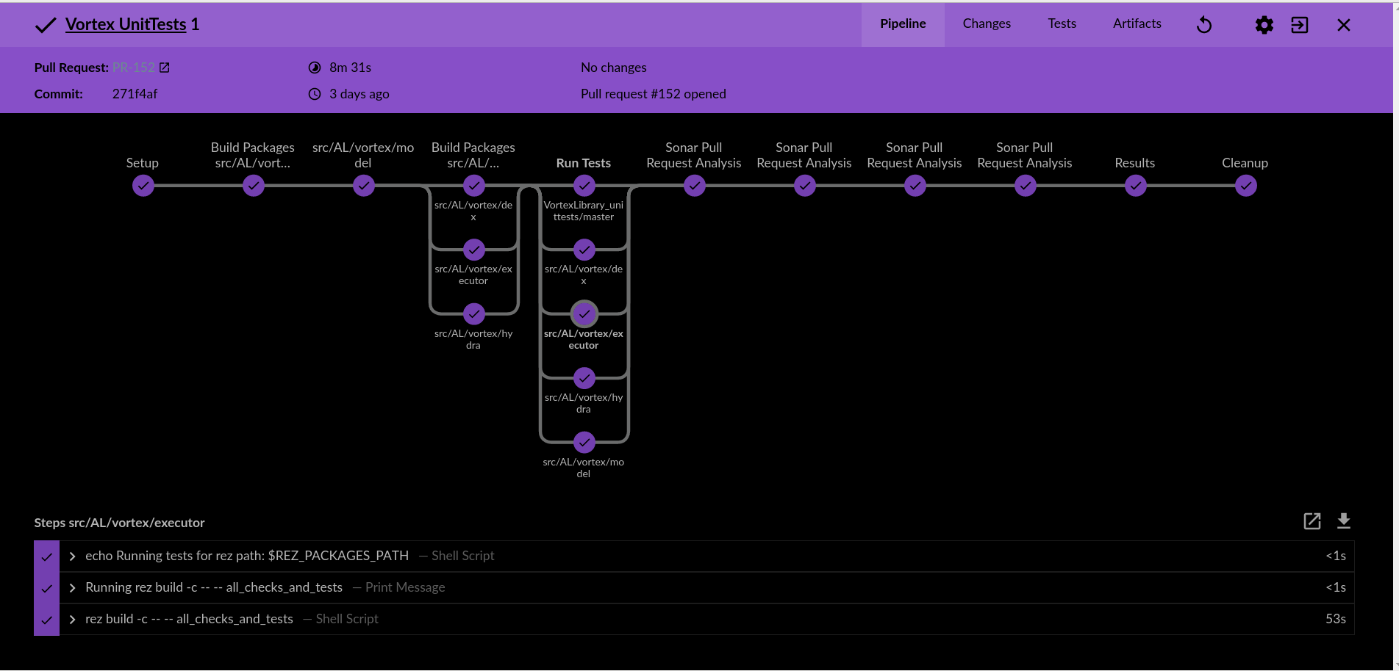
Notes:
So how to access it
@Library('my-shared-library') _
/* Using a version specifier, such as branch, tag, etc */
@Library('my-shared-library@1.0') _
/* Accessing multiple libraries with one statement */
@Library(['my-shared-library', 'otherlib@abc1234']) _
When referring to class libraries (with src/ directories), conventionally the annotation goes on an import statement:
@Library('somelib')
import com.mycorp.pipeline.somelib.UsefulClass
For Shared Libraries which only define Global Variables (vars/), or a Jenkinsfile which only needs a Global Variable, the annotation pattern @Library('my-shared-library') _ may be useful for keeping code concise. In essence, instead of annotating an unnecessary import statement, the symbol _ is annotated.
It is not recommended to import a global variable/function, since this will force the compiler to interpret fields and methods as static even if they were intended to be instance. The Groovy compiler in this case can produce confusing error messages.

Slide 28
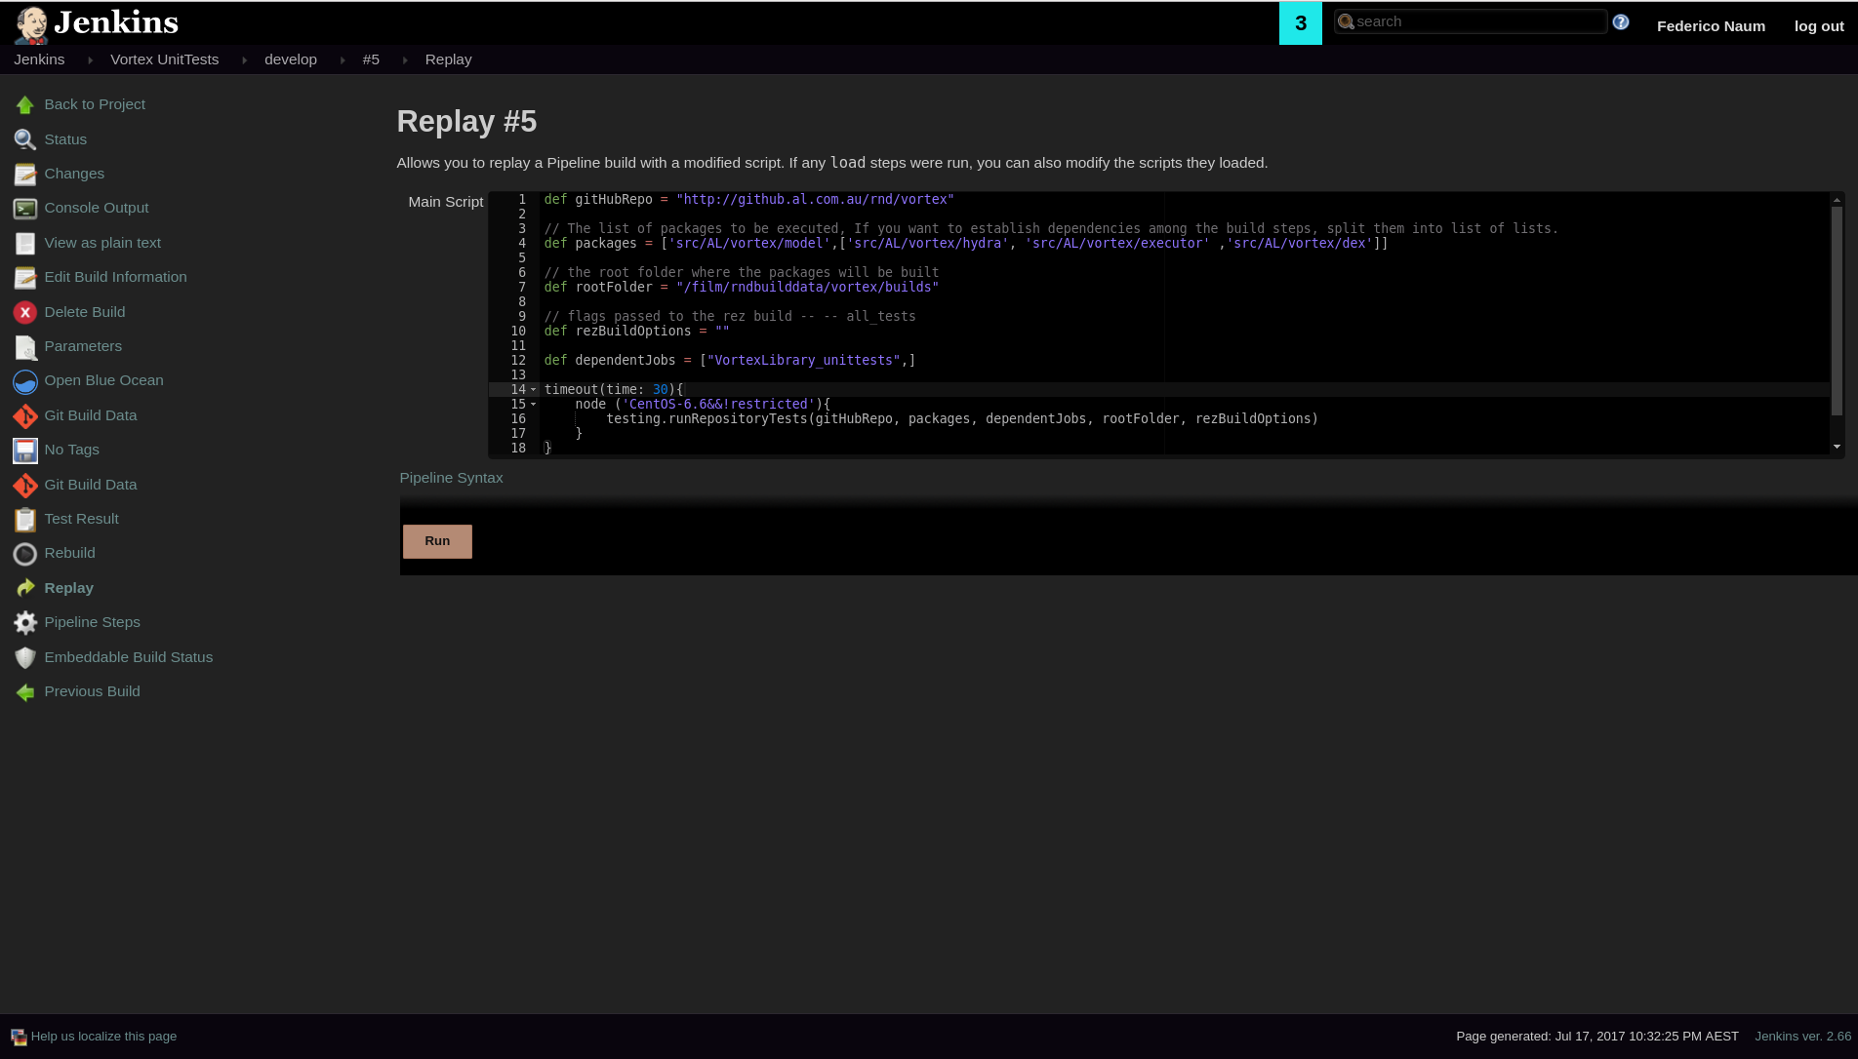

Slide 29

Notes:
Now we have all nicely setup , we have few libraries and helpers that give use we abstracted all the functionality in shared pipelines
And now we write a pipelines like this.
***Show stefano pipeline
And it does that.!!
Explain what it does… farm ..input step lightweight executors….
Now we easily add another 10 projects that use the same workflow we are happy ( happy slide -> paradise) Cloud cooks loand!!!
Now comes a developer and want to add something do an extra step, he goes change the code and introduced a bug.. Now all hour beautiful pipelines get destroyed (Cloud land destroyed)
That’s when you need to start using branches of your piepeline
29

Slide 30
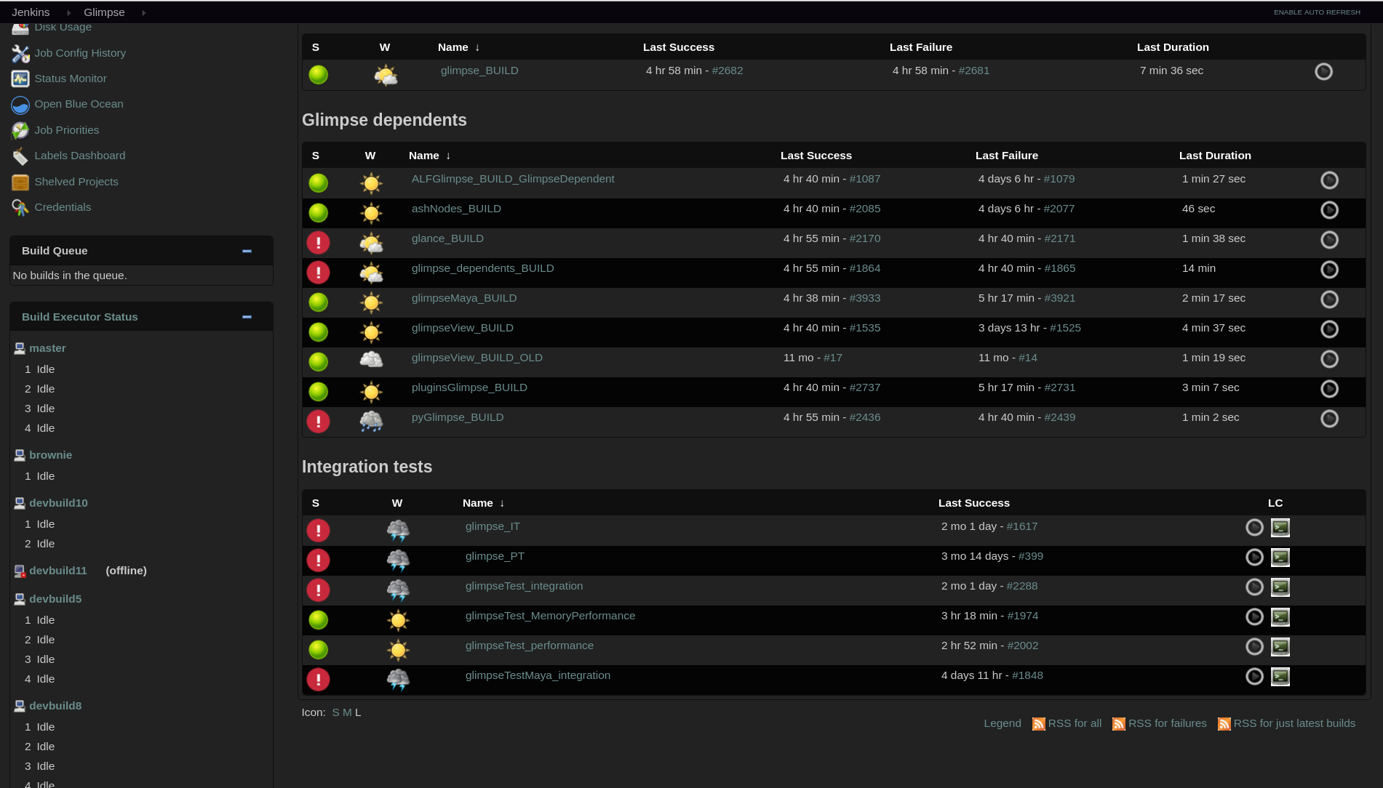

Slide 31
Agenda
Why Shared Libraries
Configuration and options
Library structure
Usage
Modification workflow
Lessons Learnt
Notes:
Wildstyle bring us the agenda for today
31

Slide 32

Modification Workflow
Create a branch of you pipeline
Access you modified library with Library('lib@branchname')
Submit pull request
Get approval
Merge to master
Notes:
This the modification workflow we use.
Other more secure/restrictive way will be in the configuration to set a
Got back and show again the configuration option!!
32

Slide 33
Agenda
Why Shared Libraries
Configuration and options
Library structure
Usage
Modification workflow
Lessons Learnt
Notes:
Wildstyle bring us the agenda for today
33

Slide 34
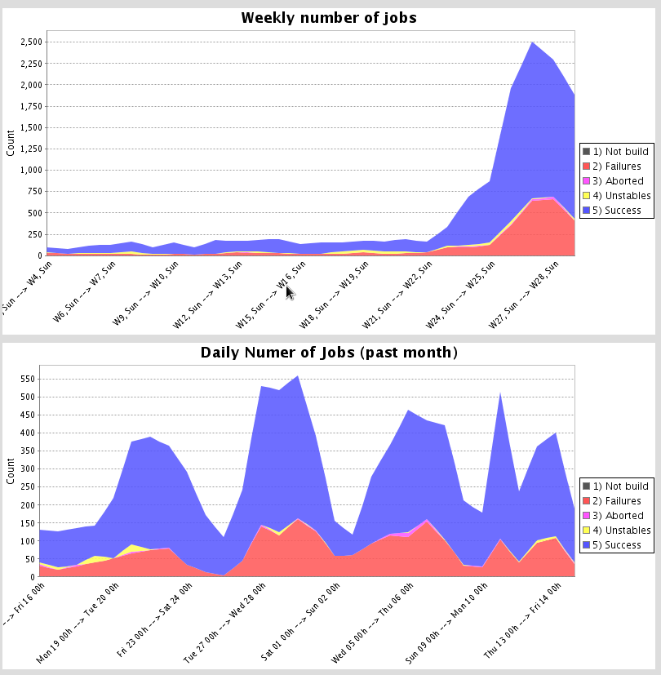
Jenkins stats
Notes:
I just gathered some stats from our Jenkins instance…. This graphs show the number of builds
We have nearly 400 active Jenkins jobs
You can see that since we started reusing our Jenkins libraries the number of builds when up
Enough introduction let’s delve into the meaty part of the talk
34

Slide 35

DO and DONTS
Do not import global variables
If you do variables/functions became static
Do not Allow direct commits to master (modification of pipelines thru branches/PR)
Do use the linter when creating shared libraries (they save time)
Do move your python/bash managed scripts into resources and create a step to run them
Notes:
Even if they were intended to be instance. The Groovy compiler in this case can produce confusing error messages.
Use the _ at the end of the library directive
Workflow use library instead of pipeline editor (in reply) If you are using things from the library that can
They have the potential of destructing all your pipelines at once. And also they pose a security concerns.
35

Slide 36
GOTCHAS
Libraries name are case sensitive (The linter does not catches that)
Linter won’t catch error of your Shared library.
PR not working the first time you add a Jenkinsfile, it needs to exists in the base branch
When you are modifying a script in the reply copy/paste first since it can fail
Or use the linter
Reply does not take the parameter from the script but from the previous build
Notes:
Even if they were intended to be instance. The Groovy compiler in this case can produce confusing error messages.
Use the _ at the end of the library directive
Workflow use library instead of pipeline editor (in reply) If you are using things from the library that can
They have the potential of destructing all your pipelines at once. And also they pose a security concerns.
36

Slide 37
Back up slides
Notes:
Folder-level Shared Libraries
Any Folder created can have Shared Libraries associated with it. This mechanism allows scoping of specific libraries to all the Pipelines inside of the folder or subfolder.
Folder-based libraries are not considered "trusted:" they run in the Groovy sandbox just like typical Pipelines.
Dinamic retrieval
Usually you define in Jenkins your shared libraries, but there is a way to retrieve a shared library dynamically without jenkins know about it. The syntax is hard to remmeber you can look that in the documentation. We haven’t had the need to use it. But I have it on the back of my mind in case someone propose me an use case. Like this.
37

Slide 38
links
https://jenkins.io/doc/book/pipeline/shared-libraries/
https://wiki.jenkins.io/display/JENKINS/Pipeline+Shared+Groovy+Libraries+Plugin
https://github.com/jenkinsci/workflow-cps-global-lib-plugin
Notes:
38

